Slide 1
mHealth: Fall Prevention using Gait Analysis
Masabho P. Milali, imran Nazakat, Manzur Rahman, Katie Sherman, Andrew Tran

Slide 2
Outline
Problem statement
Analysis – 2 of 3 fall response, pattern identification, data received
Software – Software database, data value display
Future Iteration – algorithm, dimension addition, refine look, UI, more data/trial (find publicly available data), shoe sensor (no data)

Slide 3

Problem
How do we identify if someone has fell?

Slide 4
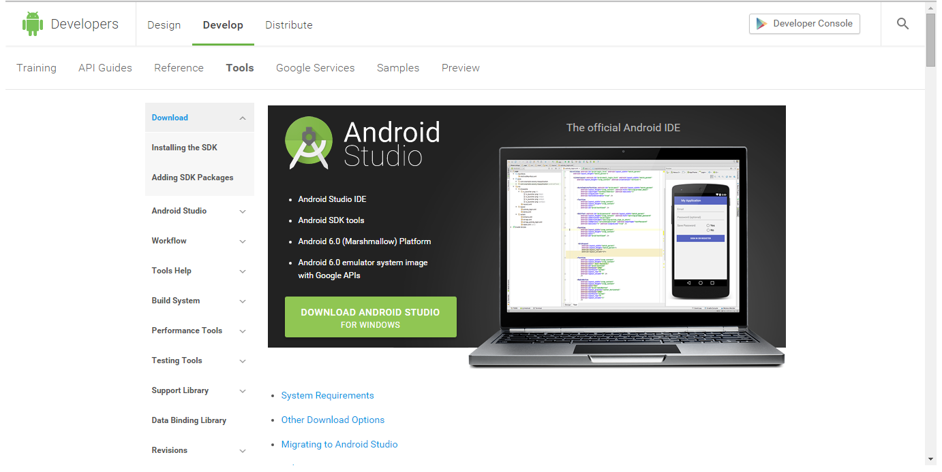
Android SDK

Slide 5
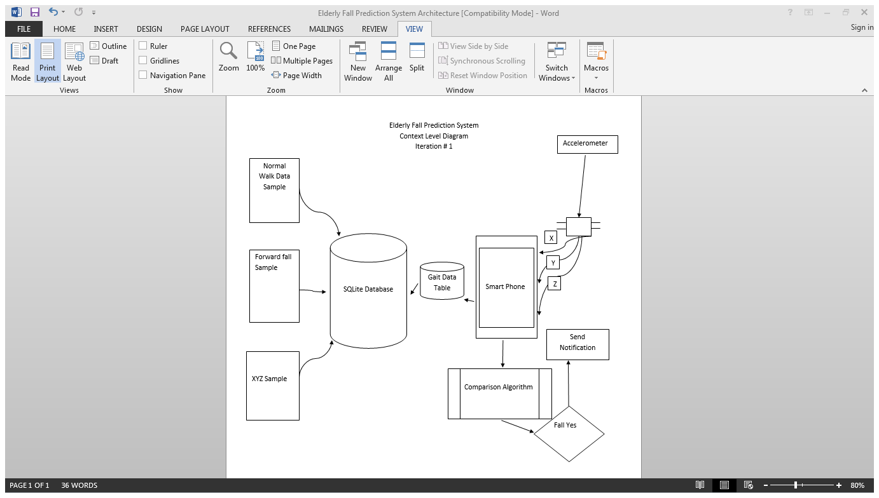

Slide 6
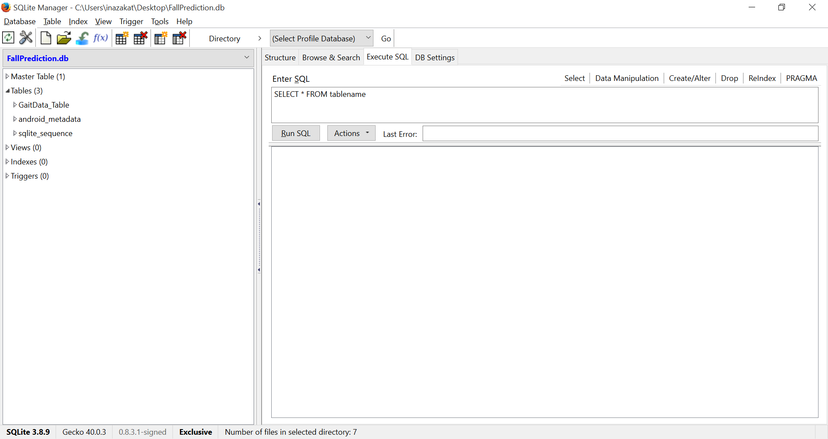
SQLite Database

Slide 7
Android SDK
Android Standard Development Kit
Java based environment
Integrated with information database
Using SQL

Slide 8
Mean (Standard Deviation) | X | Y | Z
Walking | .904 (.269) | .509 (.179) | .214 (.224)
Falling | 1.858 (1.056) | .401 (.339) | .401 (2.55)
Lull | .685 (.114) | .580 (.182) | .414 (.339)

Slide 9
Completed Tasks
Collected data with Jahangir
Preliminary analyzed gait data
Created SQLlite database
Created design document

Slide 10
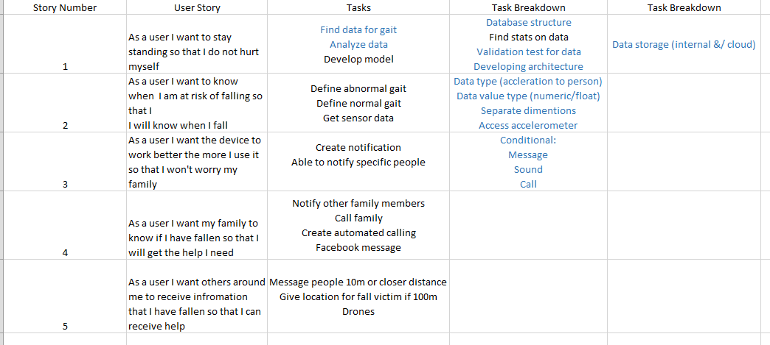
Story Cards

Slide 11
Focuses on Iteration 2
Develop algorithm
Implement algorithm
Test algorithm
Access accelerometer on the phone

Slide 12
References
Android Standard Development Kit
https://developer.android.com/sdk/index.html
SQLite
https://www.sqlite.org/
R Toolbox
https://cran.r-project.org/

